Slide 1
Module 2 Introduction to Databases and DBMSs
Lesson 4: Non-Procedural Access
Notes:
Welcome to Lesson 4 of Module 2 on the Introduction to Databases and DBMSs
- Covers non-procedural access, the most important feature of a DBMS
Database management systems are vital technology to modern organizations
Opening question:
What is the most labor intensive part of software development? Coding loops
How many orders of magnitude improvement of development time from non procedural access?

Slide 2
Lesson Objectives
Discuss the importance of non-procedural access
Explain the link between the five types of application development tools and nonprocedural access
Notes:
Tools
Database language
Visual query tool
Form development tool
Report development tool
Embedded database language inside a host programming language

Slide 3
Nonprocedural Database Access
Loop
Query: request for data to answer a question
Indicate what parts of database to retrieve not the procedural details
Improve productivity and improve accessibility
SQL SELECT statement and graphical tools
Notes:
Specify what not how
Loop buster: no loops; major difference between procedural and nonprocedural language
Trip planning analogy: specify features of trip (destination, quality of accommodations, dates, …) but not details (route, hotel research, flight research, …)
Productivity improvement: 100 times fewer lines of code

Slide 4
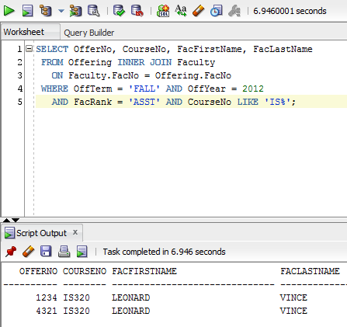
SELECT Statement Execution
Notes:
Execution of SELECT statement in the SQL Developer
Combining the Offering and Faculty tables

Slide 5
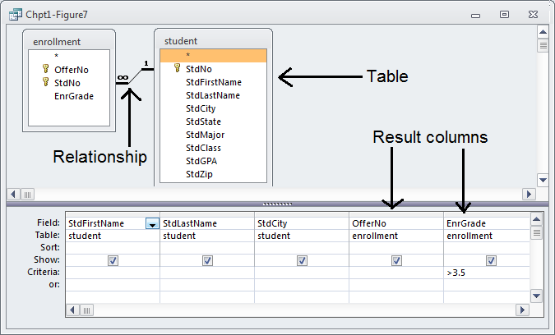
Graphical Tool for Nonprocedural Access
StdFirstName | StdLastName | StdCity | OfferNo | EnrGrade
MARIAH | DODGE | SEATTLE | 1234 | 3.8
BOB | NORBERT | BOTHELL | 5679 | 3.7
ROBERTO | MORALES | SEATTLE | 5679 | 3.8
MARIAH | DODGE | SEATTLE | 6666 | 3.6
LUKE | BRAZZI | SEATTLE | 7777 | 3.7
WILLIAM | PILGRIM | BOTHELL | 9876 | 4
Notes:
Query Design (Access)
- specify tables and columns
- Access determines connections among tables

Slide 6
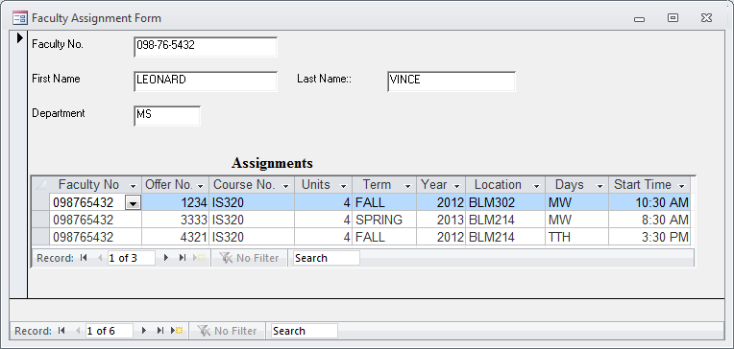
Sample Data Entry Form
Notes:
Faculty assignment form
The form can be used to add new course assignments for a professor and to change existing assignments.

Slide 7
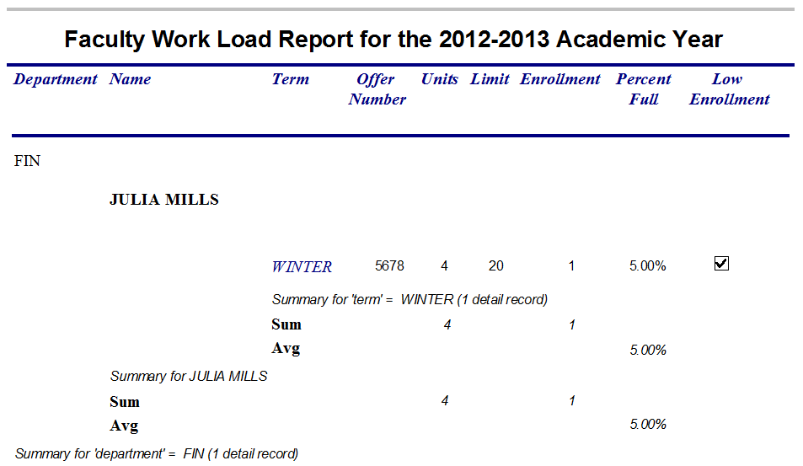
Sample Report
Notes:
May need revision
The report uses indentation to show courses taught by faculty in various departments. The indentation style can be easier to view than the tabular style shown as default output style.

Slide 8
Procedural Language Interface
Combine procedural language with nonprocedural access
Why
Batch processing
Customization (especially for ecommerce) and automation
Performance improvement
Notes:
Combine external languages (COBOL, Java, C, C++, …) with SQL
New DBMS specific languages: PL/SQL (Oracle), Transact-SQL (SQL Server)
Batch processing: much business processing is batch (collect loan applications and process together); online processing is becoming more prevalent because of the web;
Customization: customize the behavior of a data entry form
Automation: rule processing; check qoh when an order is placed
Performance: more control with a procedural language

Slide 9
Summary
Database technology vital to modern organizations
Crucial DBMS feature: nonprocedural access
Query language, visual tool, form tool, report tool, and embedding
Fundamental skill: query formulation
Notes:
DBMS are very complex products
Devote many years to understand a particular product
Learn fundamental skill of query formulation
Detailed skill that requires lots of practice
Use standard database language (SQL) in week 2

Slide 10
Sample SELECT Statement and Result
SELECT statement
SELECT OfferNo, CourseNo, FacFirstName, FacLastName
FROM Offering INNER JOIN Faculty
ON Faculty.FacNo = Offering.FacNo
WHERE OffTerm = 'FALL' AND OffYear = 2012
AND FacRank = 'ASST' AND CourseNo LIKE 'IS%';
Execution result
OFFERNO COURSENO FACFIRSTNAME FACLASTNAME
---------- -------- ------------------- --------------------------
1234 IS320 LEONARD VINCE
4321 IS320 LEONARD VINCE
Notes:
Combining the Offering and Faculty tables

